Slide 1
POWER BI · SALES ANALYTICS
13.25M
Total revenue
Sales Performance
Dashboard
7
Dashboard pages + drill-through
Revenue, profit, products, customers, sales team, geography and budget – 2021 to 2023
3 yrs
2021 – 2023 sales data
Presented by Madhu Kunchala
Top Calibo AI Academy
Notes:
SLIDE 1 - INTRODUCTION
Say: "Good morning everyone. My name is Madhu Kunchala, from Top Calibo AI Academy. Today I will show my Sales Performance Dashboard, built in Power BI."
Explain: This project studies three years of sales data, from 2021 to 2023. It covers revenue, profit, products, customers, salespeople, locations and budget.
Point to the numbers on the right: total revenue is 13.25 million, there are 7 dashboard pages plus one drill-through page, and the data covers 3 years.
Finish with: "First, let me show what I did before building the dashboards."

Slide 2
BEHIND THE DASHBOARDS
Data Preparation & Modeling
1
2
3
4
5
Append data
Build dimensions
Connect tables
Date table
Write DAX
Combined 2021, 2022 and 2023 sales into one Fact_Sales table
Product, Customer, Location, Salesperson and Date dimension tables
One-to-many relationships from each dimension to Fact_Sales
Dim_Date marked as the official date table for time intelligence
Measures for sales, profit, margin, growth and budget KPIs
KEY DAX MEASURES
Total Sales
Total Profit
Profit Margin %
YoY Growth
Budget Achievement %
Madhu Kunchala | Top Calibo AI Academy · 2
Notes:
SLIDE 2 - DATA PREPARATION & MODELING
Say: "Before making any chart, I prepared the data. Good dashboards need clean and well-organised data."
Explain the 5 steps in order:
1. Append data: I had separate sales data for 2021, 2022 and 2023. I joined them into one table called Fact_Sales.
2. Build dimensions: I made small tables for Product, Customer, Location, Salesperson and Date. These describe the facts.
3. Connect tables: Each dimension connects to Fact_Sales with a one-to-many relationship. One product can appear in many sales.
4. Date table: I marked Dim_Date as the official date table, so year, quarter and month analysis works correctly.
5. Write DAX: DAX is the formula language of Power BI. I wrote measures for sales, profit, margin, growth and budget.
Point to the yellow boxes at the bottom: these are the main measures used in every dashboard.

Slide 3
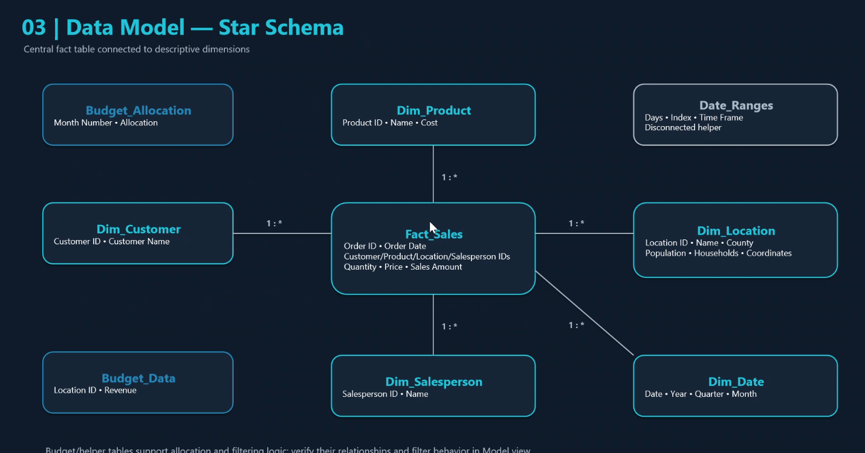
FACT TABLE ARCHITECTURE
Star Schema Data Model
Central fact table
Fact_Sales holds orders, quantity, price and sales amount
Six 1:* dimensions
Product, Customer, Location, Salesperson, Date + IDs
Helper tables
Budget_Data, Budget_Allocation and Date_Ranges drive budget & time logic
Madhu Kunchala | Top Calibo AI Academy · 3
Notes:
SLIDE 3 - STAR SCHEMA DATA MODEL
Say: "This is my data model. It is called a star schema because the fact table is in the middle and the dimension tables are around it, like a star."
Explain: Fact_Sales is the centre. It stores order ID, order date, quantity, price and sales amount.
Around it are Dim_Product, Dim_Customer, Dim_Location, Dim_Salesperson and Dim_Date. Each connects with a 1-to-many line (1 : *).
Bottom left, Budget_Data and Budget_Allocation help with budget calculations. Date_Ranges is a helper table that is not connected.
Why it matters: a star schema is fast, simple, and easy to understand. It also prevents wrong or duplicate numbers.
Finish with: "Now let us see the dashboards built on this model."

Slide 4
DASHBOARD 01 · EXECUTIVE OVERVIEW
Big picture: strong revenue, negative profit
Insert dashboard screenshot
Executive Overview page
13.25M
Total revenue
-4.06M
Total profit
-30.6%
Overall profit margin
2021
Best year – 6.04M revenue
313%
Overall budget achievement
So what: Revenue base is strong, but profitability is negative – margin recovery is the top priority.
Madhu Kunchala | Top Calibo AI Academy · 4
Notes:
SLIDE 4 - EXECUTIVE OVERVIEW
Say: "This is the main summary page. A manager can understand the whole business here in 30 seconds."
(Show your screenshot on the left, then read the cards on the right.)
Explain the numbers:
- Total revenue is 13.25 million. That is a strong sales base.
- But total profit is minus 4.06 million. The business is losing money.
- Profit margin is minus 30.6 percent. For every 100 rupees of sales, we lose about 31.
- 2021 was the best year, with 6.04 million revenue.
- Budget achievement shows 313 percent, so actual sales are much higher than the budget.
Key message: "We sell a lot, but we do not earn profit. Fixing margin is the top priority."

Slide 5
DASHBOARD 02 · SALES TREND ANALYSIS
Sales are not growing year over year
Insert dashboard screenshot
Sales Trend Analysis page
2021 · 6.04M
Highest-sales year
-1.46%
Sales fell 2021 → 2022 (5.95M)
Jan · 1.52M
Peak month (Aug is lowest at 0.93M)
Q1 · 4.24M
Best-performing quarter
-14.8%
Jan–Mar 2023 vs Jan–Mar 2022 (only 3 months of 2023)
So what: Strong January peak and August dip show clear seasonality – plan campaigns and stock around it.
Madhu Kunchala | Top Calibo AI Academy · 5
Notes:
SLIDE 5 - SALES TREND ANALYSIS
Say: "This page shows how sales change over time - by year, quarter and month."
Explain:
- 2021 had the highest sales at 6.04 million. In 2022 sales were 5.95 million, a small fall of 1.46 percent. So the business is NOT growing year over year.
- January is the best month at 1.52 million. August is the lowest at 0.93 million. This shows a seasonal pattern.
- Q1 (January to March) is the best quarter with 4.24 million.
- 2023 has only January to March data, so we cannot compare it with a full year. For the same three months, 2023 is 14.8 percent lower than 2022.
Key message: "Sales are slightly falling, and they depend on a strong January. We should plan campaigns for weak months like August."

Slide 6
DASHBOARD 03 · PRODUCT PERFORMANCE
High sales do not always mean high profit
Insert dashboard screenshot
Product Performance page
Product 47 · 296K
Highest revenue
Product 41 · 25.4K
Highest profit – prioritise
Product 24 · 289
Most units sold
-61.0%
Product 63 margin on 281K sales
-60.2%
Product 84 margin – also needs repricing
So what: Reprice or cut costs on Products 63 and 84; double down on Product 41.
Madhu Kunchala | Top Calibo AI Academy · 6
Notes:
SLIDE 6 - PRODUCT PERFORMANCE
Say: "This page shows which products make money and which do not."
Explain:
- Product 47 has the highest revenue at 296 thousand.
- Product 41 has the highest profit at 25 thousand. This is our star product and should be a priority.
- Product 24 sold the most units, 289. (Please confirm this number in your dashboard.)
- Now the problem: Product 63 sells 281 thousand but has a margin of minus 61 percent. Product 84 is also minus 60 percent.
Simple meaning: high sales but very high cost or very low price, so we lose money on every sale.
Key message: "Increase price or reduce cost on Products 63 and 84, and push Product 41 more."

Slide 7
DASHBOARD 04 · CUSTOMER ANALYSIS
Customer Analysis
Insert dashboard screenshot
Customer Analysis page
Aaron Miller · 34.6K
Top customer – also 27 orders
2.4%
Revenue from top 10 customers
Phillip Morrison · 5.8K
Highest-profit customer
-16.2K
Mark Morales profit on 30.9K sales
So what: Low concentration risk – but review discounts and costs for high-sales, loss-making customers.
Madhu Kunchala | Top Calibo AI Academy · 7
Notes:
SLIDE 7 - CUSTOMER ANALYSIS
Say: "This page shows who our best customers are and whether they are profitable."
Explain:
- Aaron Miller is the top customer, with 34.6 thousand in sales and 27 orders.
- The top 10 customers give only 2.4 percent of revenue. This is good news, because we do not depend on a few customers.
- Phillip Morrison gives the highest profit, 5.8 thousand.
- But Mark Morales bought 30.9 thousand and still gives a loss of 16.2 thousand. Big sales do not always mean a good customer.
Key message: "Keep the high-profit customers happy, and check discounts and costs for customers who cause losses."

Slide 8
DASHBOARD 05 · SALESPERSON PERFORMANCE
Top seller is not the most profitable
Insert dashboard screenshot
Salesperson Performance page
Ryan Welch · 344K
Top sales, 273 orders
-102K
Ryan Welch profit despite top sales
Sean Miller · -55K
Least negative profit
+21.9%
Carl Hall – best 2021 → 2022 growth
So what: Coach Ryan Welch and Kenneth Bradley on pricing, discount control and costs.
Madhu Kunchala | Top Calibo AI Academy · 8
Notes:
SLIDE 8 - SALESPERSON PERFORMANCE
Say: "This page compares our sales team."
Explain:
- Ryan Welch is the top seller with 344 thousand in sales and 273 orders.
- But his profit is minus 102 thousand. He sells a lot, but probably with high discounts or on low-margin products.
- Sean Miller has the best profit figure, minus 55 thousand. Note that profit is negative for the whole team, so this is the least negative, not truly positive.
- Carl Hall improved the most from 2021 to 2022, by 21.9 percent.
Key message: "Top sales does not equal top profit. Ryan Welch and Kenneth Bradley need training on pricing, discounts and cost control."

Slide 9
DASHBOARD 06 · GEOGRAPHIC ANALYSIS
Geographic Analysis
Insert dashboard screenshot
Geographic Analysis page
13.25M
California total sales
Rialto · 227K
Best-performing location
San Francisco · 148K
Low sales despite 865K population
~0
Correlation: population vs sales
Fresno
Growth opportunity (high pop., low sales)
So what: Target San Francisco and Fresno – large markets with untapped sales potential.
Madhu Kunchala | Top Calibo AI Academy · 9
Notes:
SLIDE 9 - GEOGRAPHIC ANALYSIS
Say: "This page shows where our sales come from, using a map."
Explain:
- All 13.25 million of sales come from California.
- Rialto is the best location with 227 thousand.
- San Francisco has a big population of about 865 thousand, but sales are only 148 thousand. Murrieta is also low at 148 thousand.
- I checked whether bigger population means more sales. The correlation is almost zero, so population alone does not decide sales.
Key message: "San Francisco and Fresno are big cities with low sales, so they are our best growth opportunities."

Slide 10
DASHBOARD 07 · BUDGET VS ACTUAL
Budget vs Actual
Insert dashboard screenshot
Budget vs Actual page
313%
Overall budget achievement
74
Locations exceeded budget
23
Locations missed budget
Jan · +1.35M
Largest variance (Feb +1.16M)
A180–A182
Zero sales vs budget – investigate
So what: 313% suggests budgets are set too low or mismatched by year/location – realign allocation.
Madhu Kunchala | Top Calibo AI Academy · 10
Notes:
SLIDE 10 - BUDGET VS ACTUAL
Say: "This last dashboard compares what we planned with what we actually sold."
Explain:
- Overall budget achievement is 313 percent, so actual sales are more than three times the budget.
- 74 locations beat their budget. 23 locations missed it, and A180, A181 and A182 had zero sales.
- January has the biggest positive variance, 1.35 million, then February with 1.16 million.
Important point: 313 percent is very high. It probably means the budget was set too low or does not match the right year and location. So it may not be a real success.
Key message: "Investigate the zero-sales locations and realign the budget by year and location."

Slide 11
STRATEGIC INSIGHTS
What the Data Tells Us
Strengths
Concerns
Recommendations
Strong revenue base – 13.25M total
High-profit products such as Product 41
Top locations like Rialto beat budget
Revenue fell from 2021 to 2022
Overall profit -4.06M, margin -30.6%
Products 63 & 84 and zero-sales locations drag results
Fix pricing and cost on low-margin products
Replicate top products and locations
Investigate weak locations and customers
Track YoY decline drivers closely
Realign budget by year and location
Madhu Kunchala | Top Calibo AI Academy · 11
Notes:
SLIDE 11 - STRATEGIC INSIGHTS (CONCLUSION)
Say: "To conclude, here is what the data tells us."
Green - Strengths: we have a strong revenue base of 13.25 million, products like Product 41 make good profit, and locations like Rialto beat their budget.
Red - Concerns: revenue fell from 2021 to 2022, overall profit is negative at minus 4.06 million, and Products 63 and 84 plus zero-sales locations hurt results.
Yellow - Recommendations: fix pricing and costs on low-margin products; copy what works in top products and locations; investigate weak locations and customers; watch the yearly decline; and realign the budget.
Closing line: "The business has strong sales, but the next step is to turn those sales into profit. Thank you. I am happy to take your questions."

